Slide 1


VISVESVARAYA TECHNOLOGICAL UNIVERSITY BELAGAVI
2022-23
SECAB INSTITUTE OF ENGINEERING & TECHNOLOGY, VIJAYAPURA
DEPARTMENT OF COMPUTER SCIENCE AND ENGINEERING
PROJECT WORK PHASE-2 PRESENTATION
ON
"Stock Market Prediction Using Machine Learning"
Presented By
Firdaush Alam (2SA19CS013)
Mahek Momin (2SA19CS016)
Shaquib Ehsan (2SA19CS049)
Taslim Bade (2SA19CS057)
Under the guidance of
Mrs.Nazeera.A.Madabhavi
Asst. Prof CSE,SIET

Slide 2
CONTENTS
1.INTRODUCTION
2.PROBLEM STATEMENT
3.OBJECTIVES
4.METHODOLOGY
5.IMPLEMENTATION
6.ADVANTAGES
7.CONCLUSION

Slide 3
INTRODUCTION
Stock:
A stock is a general term used to describe the ownership certificates of any company.
Stock market:
The stock market or the stock exchange is a market where you can buy stocks, commodities and bonds.
When the owners of a business want to raise money for their company, they issue their shares in the stock market.
Machine learning:
Machine learning is a subset of AI.
Machine learning algorithms are basically designed to classify things, find patterns, predict outcomes, and make informed decisions.

Slide 4

PROBLEM STATEMENT
Design and development of an model to predict stock market using machine learning approach.
Analysing the fluctuation of market.

Slide 5
OBJECTIVES
Predict the value of the financial stocks of a company.
To calculate the estimated price of stock .
movement of stock value.

Slide 6




METHODOLOGY
TOOLS
LIBRARIES
SYSTEM ARCHITECTURE
ALGORITHM USED

Slide 7
TOOLS
COMPILER OPTION
DOMAIN
JUPYTER NOTEBOOK
GOOGLE COLLAB
PYTHON
TERMINAL

Slide 8
LIBRARIES
PANDAS
NUMPY
MATPLOTLIB
SKLEARN
KERAS

Slide 9






SYSTEM ARCHITECTURE
UNDERSTANDING THE OBJECTIVES
DATA GATHERING
DATA PRE-PROCESSING
DATA VISUALIZATION
DATA PROCESSING
TRAINING AND TESTING
PREDICTIVE MODEL
1
2
3
4
5
6
DATA CLEANING
FEATURE ENGINEERING

Slide 10
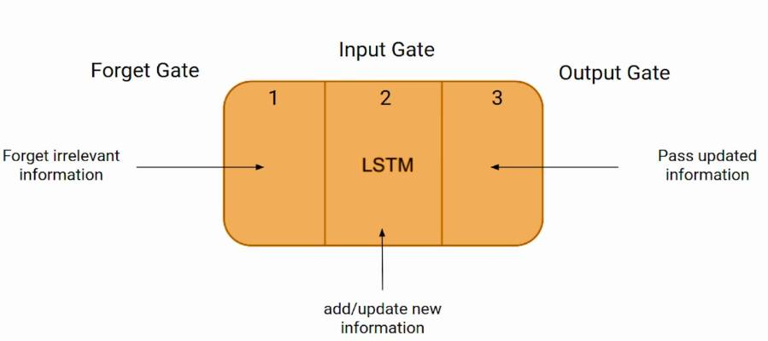


ALGORITHM USED
LSTM
Long Short-Term Memory (LSTM)
long-term memory (LSTM) is an artificial recurrent neural network (RNN) architecture used in deep learning.

Slide 11
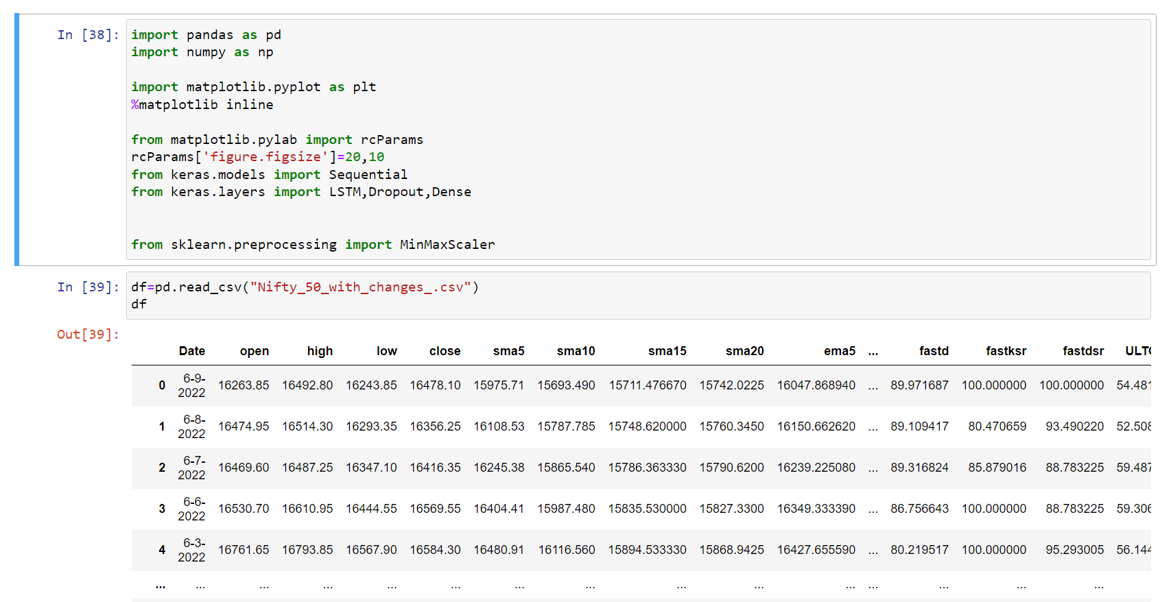
IMPLEMENTATION

Slide 12
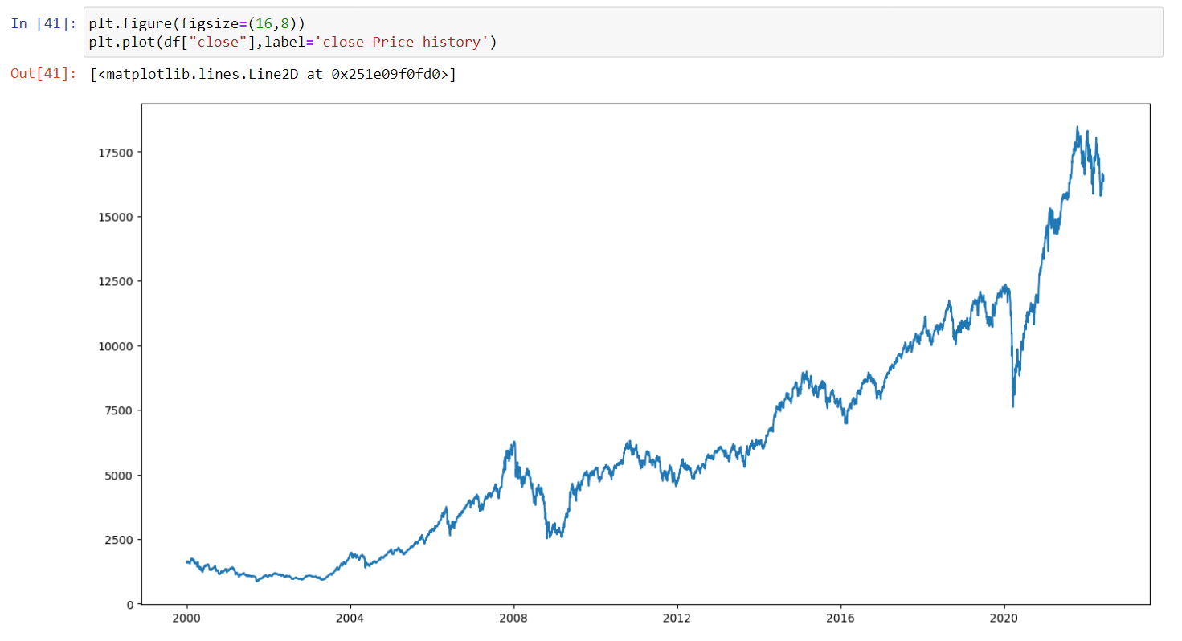
CONTINUED...

Slide 13
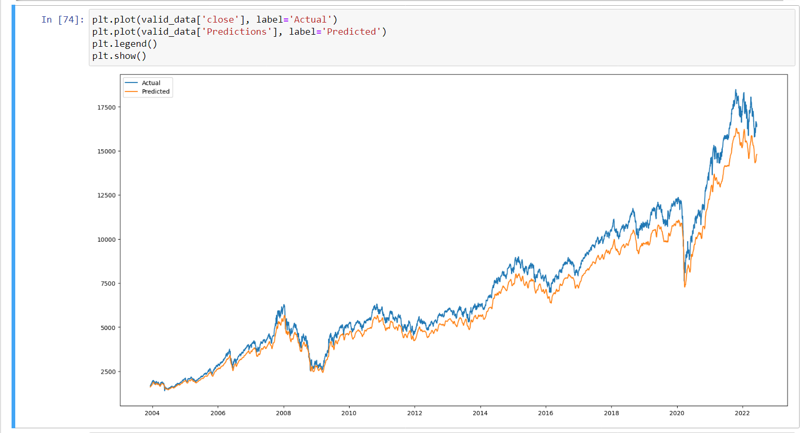
CONTINUED...

Slide 14
ADVANTAGES
1.Decision making for buying and selling of stocks.
2.Understanding of movement of stock values for the investor.
3.Minimizing the risk of loss.

Slide 15
CONCLUSION
A stock is a general term used to describe the ownership certificates of any company. Machine learning algorithms are basically designed to classify things, find patterns, predict outcomes, and make informed decisions. The proposed model will be able to predict maximum and minimum price of stocks along with the fluctuations (rise and fall). Resultantly it will certainly help the investors to predict and understand the stocks before investing.

Slide 16
REFERENCES
Karim,Somshubra Majumdar,Houshang Darabi and Shun Chen,”LSTM fully.
Sahil vazirani, Abhishekh sharma and Pavika sharma "Analysis of various machine learning algorithm and hybrid model for stock market prediction using python".
Ashish sharma, Dinesh bhuriya and Upendra singh"Survey of stock market prediction using machine learning approach.
Sumeet sarode, Harsha G. Tolani, Prateek Kak,Lifna C S "Stock price prediction using machine learning techniques".
Schumaker, Robert, and Hsinchun Chen. "Textual analysis of stock market prediction using financial news articles." AMCIS 2018 Proceedings (2018): 185.

Slide 17


